Slide 1



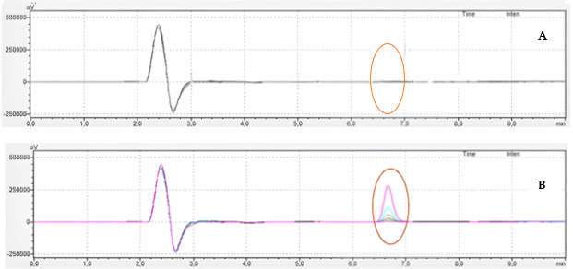
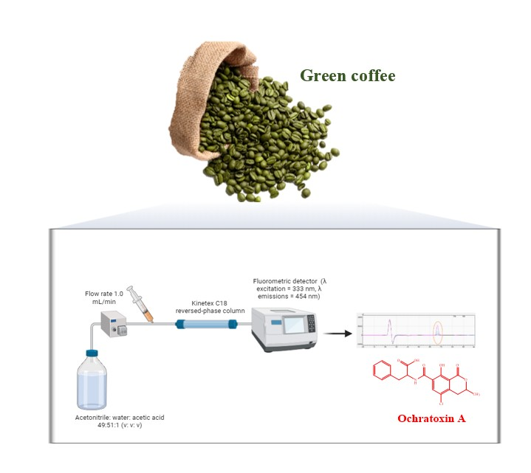
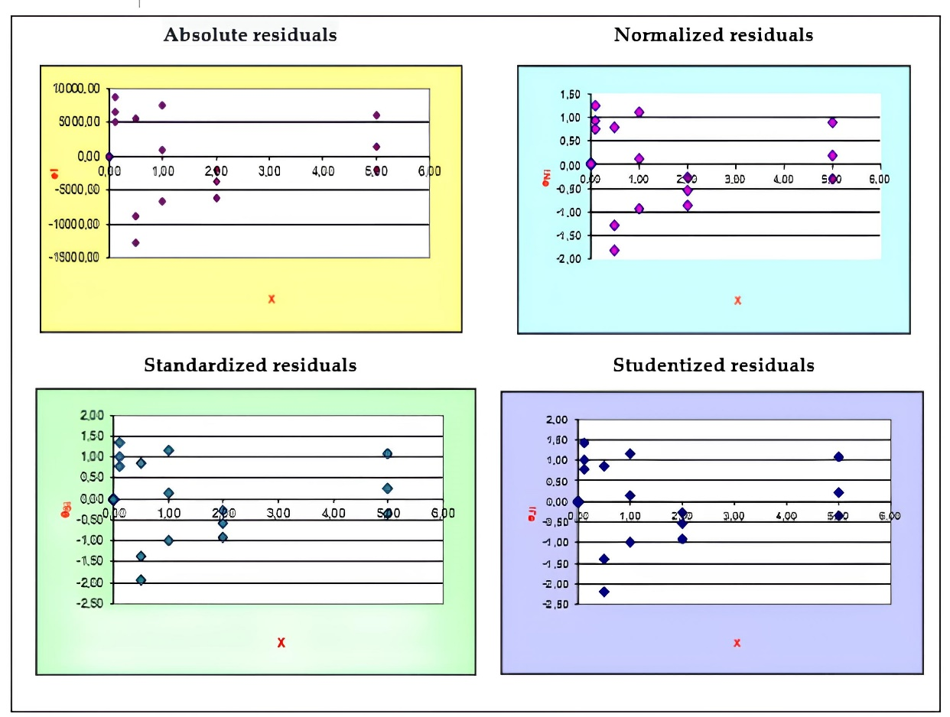

VALIDATION OF A CHROMATOGRAPHIC METHOD TO DOSE OCHRATOXIN A IN GREEN COFFEE
Mario Tessieri and Irene Dini
Pharmacy Department- FedericoII University of Naples (Italy)
INTRODUCTION & AIM
RESULTS & DISCUSSION
Green coffee and its derivatives, which include beverages, dietary supplements, additional foods, and nutraceuticals, are appreciated for their potent antioxidant properties. However, there is a significant risk of the contamination of green coffee and its products by fungi and their mycotoxins, particularly ochratoxin A (OTA). This contamination can happen in traditional and organic green coffee during various stages, such as berry picking, crop storage, and transportation. Ochratoxin A (OTA) is known to have harmful effects on the kidneys (nephrotoxicity), liver (hepatotoxicity), and nervous system (neurotoxicity) and can cause congenital disabilities (teratogenicity) and cancer. This work validated a chromatographic method to measure OTA levels in green coffee following the UNI CEI EN ISO/IEC 17025: 2018.
Selectivity was attributed to the absence of signals at the retention time in which the OTA signal appears when a sample where OTA is absent
The regression coefficient was 1
Residual analyses confirmed the calibration curve’s linearity:
The standardized residuals between − 2 and + 2 were more than 98%
The homoskedasticity's violation was excluded since residuals fell in the interval + 3 − 3
METHOD
Green coffee sample preparation
The green coffee bean (15.0 g) were extracted with MeOH/NaHCO₃ (1/1, w/w; 150 mL ) thirty minutes under stirring [29]. The extract was filtered, and filtrate was centrifuged for 15 at 1300 rpm
Elimination of interferents
The extract (10 mL) was diluted with phosphate buffer saline and chromatographed on an affinity column.
Ochratoxin dosage
OTA were obtained by using an HPLC equipped with Kinetex C18 reversed-phase column a fluorimetric detector RF-20Axs (λ excitation = 333 nm, λ emissions = 454 nm). The mobile phase was acetonitrile: water: acetic acid 49:51:1 (v/v/v), and the flow rate was 1.0 mL/min.
Method validation
The test was validated according to UNI ENI 17025:2018
Linearity, LOD, LOQ, measuring range, and calibration uncertainty were obtained from the calibration curve
R² and the Anova test confirmed linearity
LOD=3.3 σS ; LOQ=10 σS, respectively (σ = relative standard deviation; S = slope of the standard curve).
The intra-day and inter-day precision were determined measuring the RSD (%)
The method's uncertainties were calculated with the metrological approach,
The test’s ability to ​​detect the minimum OTA levels permitted by the current legislation in coffee (3 µg/kg - 5 µg/kg) was confirmed by:
LOD (0.047 µg/kg),
LOQ (0.11 µg/kg)
Measuring range (0.11 µg/kg to 5 µg/kg )
Precision (standard deviation = 0.0073)
Accuracy (± 0.64 µg/kg)
Uncertainty :
Resulting uncertainty uc (y) = 0.042
Extended uncertainty U(y) = 0.084
K= 2 (confidence level$≅$ 95.4%)
CONCLUSION
The analytical method was considered sensitive, precise, accurate, and suitable for determining ochratoxin concentrations in compliance with the regulations in force.
The analytical method's validation is essential to guarantee data traceability and avoid measurement errors.
FUTURE WORK / REFERENCES
European Commission. Commission regulation (EU) 2022/1370 of 5 August 2022 amending the Regulation (EC) No 1881/2006 as regards maximum levels of ochratoxin A in certain foodstuffs. Off. J. Eur. Union 2022, L 206/11, 5–24.
UNI CEI EN ISO/IEC 17025:2018. General Requirements for the Competence of Testing and Calibration Laboratories; ISO: Geneva, Switzerland, 2018.
https://sciforum.net/event/Foods2024

