Slide 1
Frequency and time domain analysis of guided waves in plate-like structures
F. Ricci , E. Monaco, V. Memmolo, L. Esposito
2025

Slide 2
Outline
Motivation
Frequency and time domain approaches in wave propagation problems (Damage Localization)
Solve the GW problem in the frequency domain and compare with the solution in the time domain
Application to a plate with a damage
Results & Conclusions

Slide 3
Motivations
Solving the GW problem in the time domain either numerically or experimentally gives detailed information about certain defects or damaged inside a structure, but it may require a big effort if many frequencies are required or large structures are investigated (multi-damages with different sizes and locations).
Working in the frequency domain is generally more efficient, but it can not capture transient phenomena which occur over short time periods. It indirectly assesses structural response through transfer functions, but requires further analysis to determine stresses, displacements, and accelerations.
The faster solution in the frequency domain (FDA) can be directly used for damage localization and from this the time domain solution (TDA) can be reconstructed for a more accurate damage detection.

Slide 4
Frequency and Time Domains
In many past works the authors presented a damage detection approach based on the combination of low frequency vibrations (statistical Damage Indices) and ultrasonic waves.
The proposed approach thus makes it possible to identify very small areas of damage with a high level of reliability.
the low frequency vibration-based analysis is capable to identify widespread damage within the structure (Statistical Damage Index) from a large dataset collected by a network of distributed sensors and actuators in relatively complex structures
the analysis of the waveform signals of propagating GW provide more detailed information on the location and nature of smaller defects from a waveform data set provided by the same network of distributed sensors and actuators
low frequency vibration-based analysis
GW propagation analysis

Slide 5
Time Domain vs Frequency Domain
Time and frequency domain analysis (TDA and FDA) are two fundamental techniques employed to evaluate the dynamic behavior of a system, each offering advantages and applications.
TDA Advantages it captures transient behavior it handles nonlinear interactions it directly evaluates the structural response allowing for the determination of stresses, displacements, and accelerations Disadvantages high computational cost, especially for complex structures and long simulation periods limited frequency resolution as it may not provide sufficient frequency resolution for analyzing specific frequency components of the wave spectrum | FDA Advantages it is computationally efficient, suitable for analyzing large structures or long-term wave conditions it provides high frequency resolution, making possible detailed analysis of specific frequency components of the wave spectrum Disadvantages linear relationship between input forces and structural response (it may not be valid in certain conditions) it can not capture transient phenomena it indirectly assesses structural response through transfer functions, requiring further analysis to determine stresses, displacements, and accelerations

Slide 6
Time Domain vs Frequency Domain
The selection of the approach depends on the specific requirements and objectives of the problem to be solved.
TDA is preferred when transient behavior, nonlinear interactions, or direct structural response assessment are crucial.
FDA is preferred for spectral analysis and frequency-dependent structural response.
It is concluded that TDA and FDA are complementary rather than competing techniques and they may be both employed to obtain a more comprehensive understanding of certain dynamic problems.

Slide 7
GW in a Layered Plate
500 mm
F (t)
Sensor spacing 50 mm
Aluminum Alloy
3 mm
1
2
3
4
n
50mm
y
18mm
1000 mm
x

Slide 8
GW in a Layered Plate (Time Domain)
4
B
A
500 mm
d
Receiver #4
F (t) 200kHz
4d
4
B
3 mm
Aluminum Alloy
A
4d
1000 mm

Slide 9
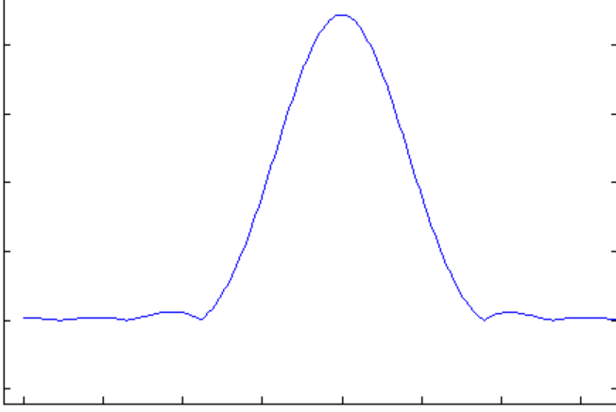
GW in a Layered Plate (Frequency Domain)
F (ω)=1
4
B
A
4
B
A
Receiver #4:
FRF (ω) -> FFT input signal -> R#4 (ω) -> iFFT -> R#4 (t)
time
frequency
frequency

Slide 10
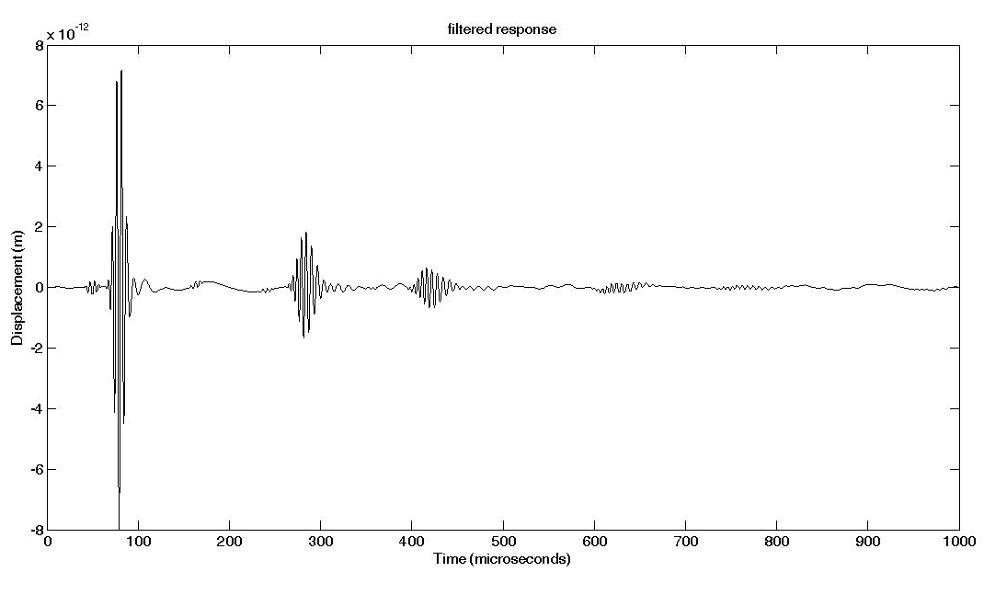
GW in a Layered Plate
Time domain analysis (transient explicit FEM)
Time domain solution from the Frequency domain analysis ( Freq. Response FEM)
200kHz

Slide 11
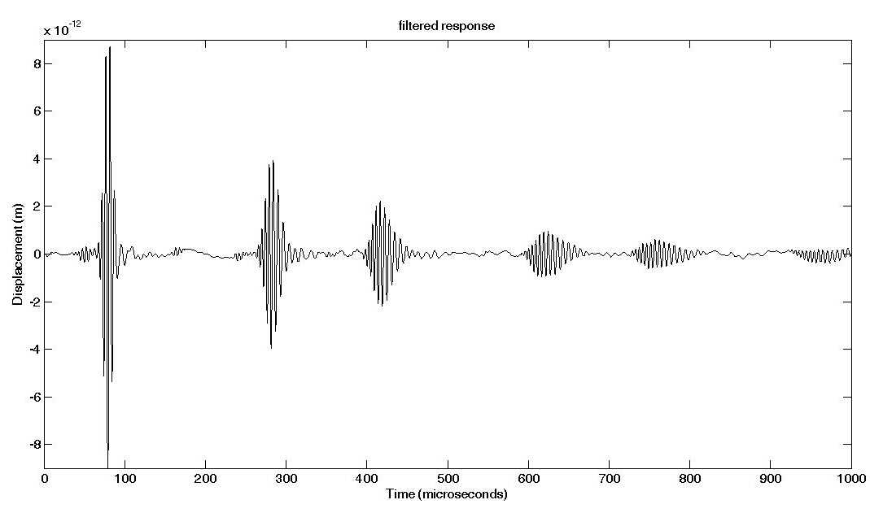
GW in a Layered Plate
Time domain analysis (transient explicit FEM)
Time domain solution from the Frequency domain analysis ( Freq. Response FEM)
200kHz and damping match

Slide 12
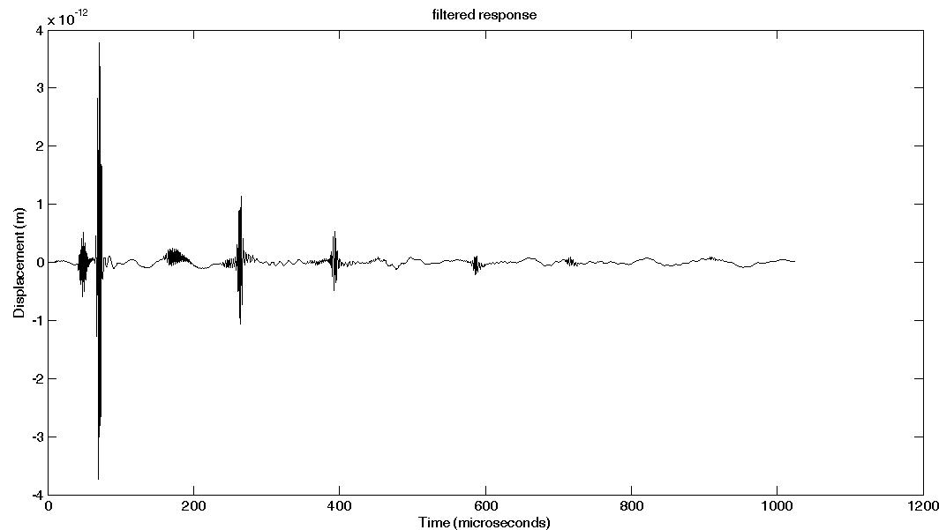
GW in a Layered Plate
Time domain solution from the Frequency domain analysis ( Freq. Response FEM)
400kHz

Slide 13
Layered plate with a Damage
500 mm
F (ω)
Sensor spacing 50 mm
Aluminum Alloy
3 mm
1
2
3
4
n
10
50mm
y
18mm
1000 mm
x

Slide 14
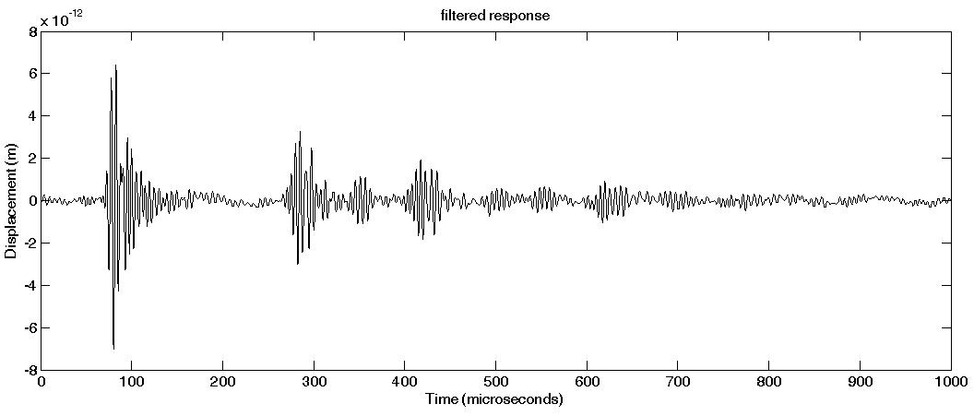
Layered plate with a Damage
Time domain analysis (transient explicit FEM)
Time domain solution from the Frequency domain analysis ( Freq. Response FEM)
F
2
Aluminum Alloy
18mm

Slide 15
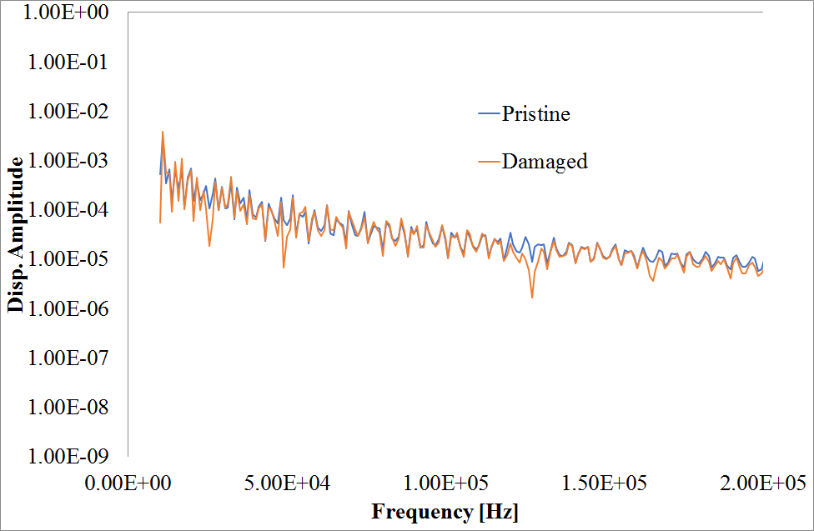
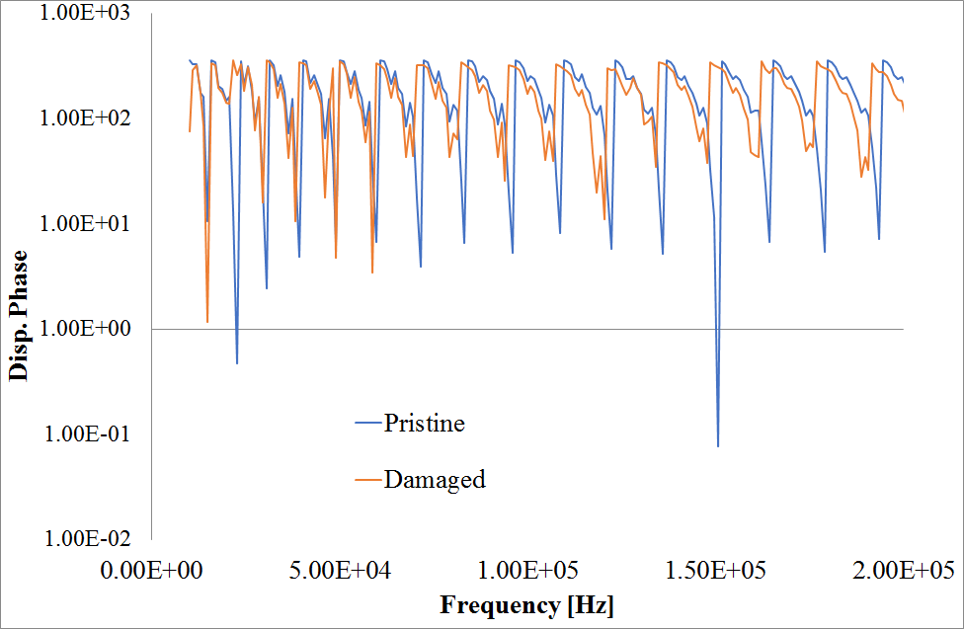
Layered plate with a Damage
Frequency domain analysis

Slide 16
Conclusions
Concluding remarks
Solving the GW problem in the time domain either numerically or experimentally gives detailed information about certain defects or damaged inside a structure, but it may require a big effort if many frequencies are required or large structures are investigated (multi-damages with different sizes and locations).
Working in the frequency domain is generally more efficient, but it can not capture transient phenomena which occur over short time periods. It indirectly assesses structural response through transfer functions, but requires further analysis to determine stresses, displacements, and accelerations.
The accurate time domain analysis (TDA) of GW propagation for any input sources can be reconstructed from a faster frequency domain analysis (FDA) with the same accuracy level.
A combination of FDA and TDA can be used for an efficient damage detection depending on the accuracy level required.

Slide 17
Thanks
for your attention
Questions?
Notes:
Deeper details on Pitch-catch analysis for Global-local approaches and EMI measurements. Within the project it is supposed to switch from Lab hardware to Italsystem device and SW

