Slide 1




Fair Trade consumption in Italy: the role of personal values and contextual factors
A. Coppola, F. Caracciolo, M. Amato, T. Panico
Dipartimento di Agraria, Università degli Studi di Napoli Federico II

Slide 2

Sustainable consumption and Fair Trade
Sustainable consumption is a possible lever of sustainable development
Sustainable or ethical consumption can be defined as:
“the conscious and deliberate choice to make certain consumption choices due to personal and moral beliefs’’ (Crane and Matten, 2004; page 290)
Ethical consumption covers two different aspects: environmentally friendly and socially conscious consumption patterns
This study focuses on the second one.

Slide 3
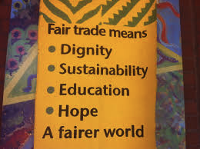
What is FAIR TRADE?
Fair Trade is a category of social consumption
an alternative approach to trade relations which aims to improve economic and social conditions of disadvantaged producers in the Third World, impoverished by the relations prevailing in International Trade.
Fair Trade products are manufactured and traded on the basis of cooperative commercial principles rather than competitive ones, in order to ensure a fair price and fair working conditions for workers, manufacturers and operators of the commercial sector.

Slide 4
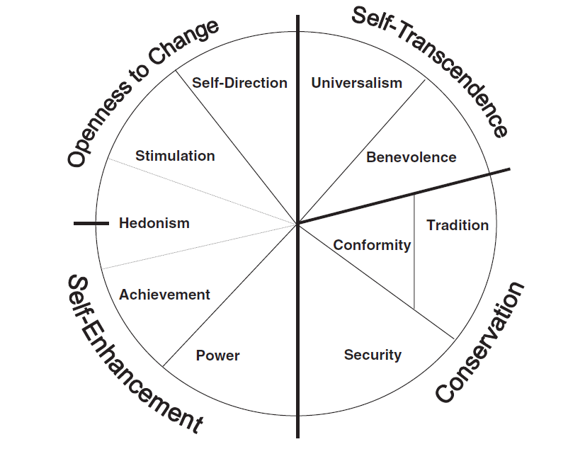
The background
Value Circle of Schwartz:
10 basic values that can be described by their motivational goals.
According to Schwartz and Bilsky (1987) values are ‘‘concepts or beliefs, pertaining to desirable end states, which transcend specific situations, guide selection or evaluation of behaviour and events”
Values attitudes behaviour
The relationship between values and behaviour seems to be indirect through moderator variables
Food-Related Lifestyle (FRL) (Grunert, 1993; Grunert et al. 1995; Brunsø and Grunert, 1995).
Social context

Slide 5

Research aims
Investigating the role of socio-economic context as intermediate moderator between personal values and fair trade consumption in Italy
  Do the level of economic development, the quality of life and the social environment influence the purchase of fair trade (FT) products?
  Does socio-economic context interact with the Schwartz’ set of values in affecting the pro-social behaviour?

Slide 6

Data and Methods
Web administered questionnaire submitted through the website of the General Assembly of the Italian Fair Trade (AGICES)
586 questionnaires
2 Factor Analysis:
  Explanatory FA on the values’ scale, to get the main motivational types linked to the personal values,
  Confirmatory FA on a set of variables referred to NUTS3 level, to identify an indicator of the social context
ordered probit regression: the expenditure class of fair trade products is related to components extracted in the FAs and to demographic and economic variables (age, sex, personal income)

Slide 7
Data and Methods
Variable | Classification | Frequency (%)
Expenditure in Fair trade products | 0 € expenditure 0€ < expenditure <10€ 10€ < expenditure<50€ expenditure >50€ | 19.4 10.7 28.5 41.3
Age | 18 - 25 | 13.8
 | 26 - 35 | 26.5
 | 36 - 45 | 27
 | 46 - 55 | 19.1
 | 56 and more | 13.7
Gender | Male | 40.3
 | Female | 59.7
Education | Low level | 3.2
 | Secondary schools | 45.4
 | Degree | 51.9
Income | < 1.000 € | 13.3
 | 1.000 - 2.000 € | 42.7
 | 2.000 – 3.000 € | 26.1
 | > 3.000 € | 17.9
Geographic area | Central and Northern Italy | 40.8
 | Southern Italy | 59.2
Household members | 1 | 12.1
 | 2 | 21.2
 | 3 | 22.4
 | 4 | 34.1
 | 5 or more | 10.2
Presence of children less than 12 years old | No | 76.3
 | Yes | 23.7

Slide 8
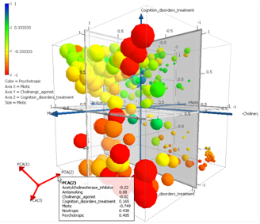
Main Results
Explanatory Factor Analysis on Schwartz’ values
 | Self-enhancement + Hedonism | Self-transcendence +self direction | Conservation
S_DIRECTION | 0.51 | 0.57 | -0.02
POWER | 0.63 | -0.26 | 0.51
UNIVERSALISM | -0.03 | 0.84 | 0.06
ACHIEVEMENT | 0.75 | -0.16 | 0.31
SECURITY | 0.26 | 0.16 | 0.69
STIMULATION | 0.78 | 0.19 | -0.22
CONFORMITY | 0.04 | 0.11 | 0.79
TRADITION | -0.03 | 0.41 | 0.64
HEDONISM | 0.76 | 0.19 | 0.16
BENEVOLENCE | 0.05 | 0.78 | 0.25
KMO=0.76; Bartlett’s χ² statistics: 1693, p-value <0.001
65% of the variance

Slide 9
Social Capital Index
Confirmatory Factor Analysis on context indicators (Nuts3 level)
Latent variable: Social Capital Index (Santini, 2005)
# Voluntary per inhabitants | +0.71***
# Public TV subscriptions per inhabitants | +0.99***
% Tornout, national elections. | +0.85***
# Murders per inhabitants | -0.95***
# Crimes per inhabitants | -0.87 ***

Slide 10
Social Capital Index
Confirmatory Factor Analysis on context indicators (NUTS3)
RMSEA: 0.06; CFI - Comparative fit index: 0.975; TLI - Tucker-Lewis index: 0.938

Slide 11
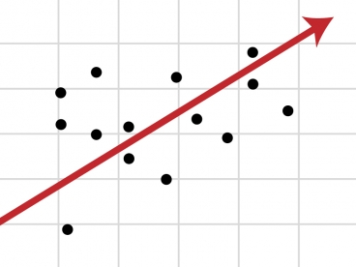
Main Results
Ordered probit on expenditure
Variable | Coeff. | t-stat | p-value
Self-enhancement &Hedonism | 0.116 | 2.44 | 0.015
Self-transcendence | 0.105 | 2.14 | 0.032
Conservation | -4.56 | -2.15 | 0.031
GDP pro capite | 0.553 | 2.20 | 0.028
GDP x Self-enhancement&Hedonism | N.S
GDP x Self-transcendence | N.S
GDP x Conservation | 0.500 | 2.25 | 0.024
Social capital | 0.069 | 1.14 | 0.253
Soc. capital x Self-enhancement&Hedonism | N.S
Soc. capital x Self-transcendence | 0.08 | 1.69 | 0.092
Soc. capital x Conservation | N.S
Income | 0.175 | 2.26 | 0.024
Sex | 0.160 | 1.61 | 0.110

Slide 12

Some conclusions
The relevance of Schwartz’ value model in the Fair Trade consumption is confirmed
  the expenditure in FT products is higher when values such as universalism, benevolence and self-direction characterize people motivational orientation, and the more they are open to change
Socio-economic context influences the consumption behaviour
  Directly
    The economic wealth is relevant
    No effect is proved for the social capital
  Indirectly
    Economic wealth interacts with conservation pushing consumption behaviour in the same direction
    Social Capital strongly interacts with universalism and benevolence increasing expenditure in FT products

Slide 13

Further research developments
To apply the analysis to more general sample (not “selected” through the AGICES Website)
To apply an unique structural equation model in order to analyze the relationship between values and behaviour through attitudes and intentions.

Slide 14
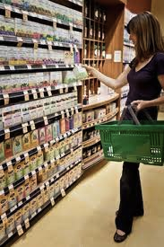
Considerations
The results of our research suggest the possibility to implement market segmentation strategies to target specific communication policies toward consumer segments most likely to purchase FT products.

Slide 15

Today, the development paths of the markets in the Western developed countries, are characterized by an increasing importance of the ethical attributes of products.

Slide 16

Further research developments
The traditional FT linked to developing countries, represents only a segment in a larger market of FT products.
An important segment is developing in western markets. However, it seems to suffer from the same problems that characterize the traditional FT:
a strong purchase intention but poor sales volumes
The food processing industry is focusing on the ethics attributes and ethics certifications; this justifies the need for further studies to learn about emerging market dynamics.

Slide 17

Thanks

